Slide 1

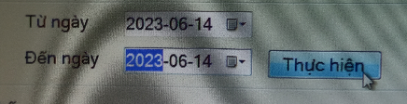
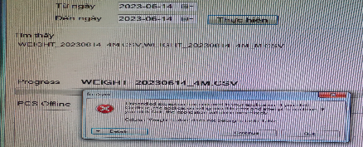




Line: Line 1M-6M
PIC: Huong
Date: June
Expn: 0$
Status: Idea
◆Before
◆ After
Step 1:
Select Synchronize
Step 1:
Select Synchronize
Step 2:
Select time, update
Step 2:
Select time, update
Can’t Synchronize data
Can’t Synchronize data
Step 3: Repair
Log file name
Step 3: Repair
Log file name
Synchronize data OK
Synchronize data OK
Currently, DP Line 1M-6M can’t synchronize data to log file weight check to weight system
Lost time for repair Log file name of carton box:
5 min*6 Line*2 times*22 date*12 months=15,850 mins <=>264h/ Year
We want to delete Step when update synchronize data
Save time for repair Log file name of carton box:
2 min*6 Line*2 times*22 date*12 months=6,336 mins <=>106h/ Year ⬄ save time 158h/ Year

